Slide 1
Python Deeper Dive: Intro to Git
Day 9

Slide 2
Agenda
Version Control Systems in general
Git
Commits
Big picture
How-to
Branching
Big picture
How-to
Remote repositories
Big picture
How-to

Slide 3
Version Control Systems

Slide 4
The Problem: keeping track of work history is hard!
Worse when you consider that:
People may need to work on something at the same time
And in different locations
Over the lifetime of a project, it may not even be the same people

Slide 5
The Solution: Version Control Systems (VCS)
“version control, also known as revision control or source control, is the management of changes to documents, computer programs, large web sites, and other collections of information.” (thanks Wikipedia)
A VCS is a system built to help manage version control
Very common in tech/software/data as the primary way of saving, organizing, and sharing work
Examples: Git (our choice and the most popular), Subversion, and many others (for instance, Google has a homegrown one)

Slide 6
Git

Slide 7
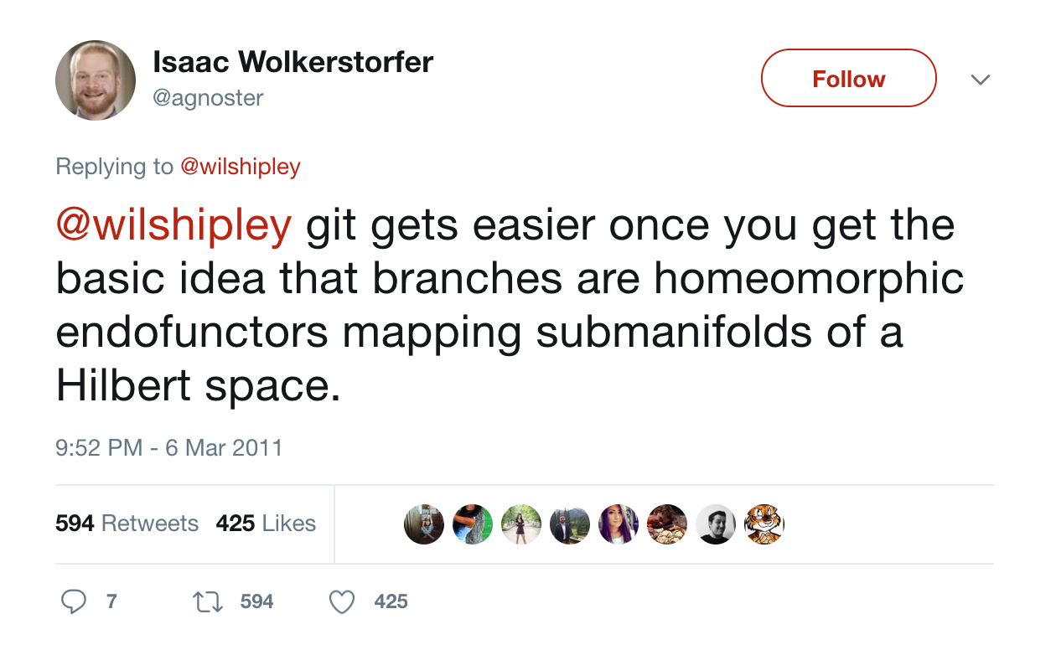
It’s not this bad… but Git is known for having a bit of a learning curve

Slide 8
Commits

Slide 9
Git works in commits
Git thinks of project history as a series of snapshots or checkpoints. The Git term for this is commits
When you’re ready to save your work, you can “make a commit”, “commit your files”, or just “commit”. Think of this as taking a snapshot of your entire project, or repository
In the future, you can always go back to previous commits, no matter what you’ve done to your code in the meantime
Other metaphors
Reaching a checkpoint in a video game
Time Machine on Mac (or other backups)
Saving a v37 (except more sophisticated)

Slide 10
Another way to think about a commit

Slide 11
A project is just a series of commits
Commit 0
Commit 1
Commit 2
Wrote a readme!
Wrote most of the code
Added tests

Slide 12
Demo
git init
Make some files
git add
git commit
Repeat a couple times
git checkout

Slide 13
Branching

Slide 14
All commits live on branches
The default or main branch is nearly always called the master branch
However, you can have many branches
For instance, you might start a feature branch in order to work on a new experimental feature. If we’re working on issue #53 in our backlog, let’s call the branch “iss53”

Slide 15
Branching
At first, our branch and the master branch will look exactly the same:
Then, maybe we’ll do some work and make a commit on the “iss53” branch. Then, it’ll look like this:

Slide 16
Branching (cont’d)
In easy cases, once we’ve finished our work on the feature branch, we’ll be ready to merge it back into the master branch. Then we can get rid of the feature branch, since the master branch will contain all of the commit information anyway.
Branching may not seem that important now. However, it is foundational for more complex workflows and for working with other people on the same project. For now, remember that branching is a useful way to work on separate parts of the project at the same time

Slide 17
Demo
git checkout –b
Make some files
git add
git commit
Switch back and forth to show difference between branches
Merge into master

Slide 18
Remote repositories

Slide 19
Introducing remote repositories
So far, we’ve been talking only about the local environment – that is, a local repository on your computer
Git really starts to shine when you have multiple workers on their own machines trying to sync code to a remote repository – one hosted on another machine accessible to everybody (e.g. on the Internet or some other network)

Slide 20
Remote repositories
In many workflows, the remote repository serves as an even-more-central master branch
Common workflow:
Sync your local repo with the remote repo to get the most up to date version of the code
Create a feature branch
Do some work
Commit your changes
Merge your feature branch into your local master
Push your local master to the remote master
Now everyone has access to the code you just wrote

Slide 21
Demo
Make GitHub repository
git add remote
git push
Change some files
git pull

Slide 22
Other Resources
https://git-scm.com/book/en/v2/Git-Branching-Basic-Branching-and-Merging - this tutorial is where I stole some of the graphics, and some of the other chapters may be helpful as well
https://recompilermag.com/issues/issue-1/how-to-teach-git/ - contains a cheat sheet and some helpful definitions. However, also covers a lot more than we talked about here. Be careful – bite off a bit at a time
https://www.slideshare.net/HubSpot/git-101-git-and-github-for-beginners - another slide-show introduction

